Slide 1
Electronic Recording System (Heart Disease Prediction System)
Shreerang Paradkar - 42
Kedar Patil - 44
Amit Sawant - 57
Project Guide
-Mrs. Sana Shaikh

Slide 2
Problem Statement
Development of software to be used for practical applications rather than only in research field.
Doctors not only need to know the main symptoms in a patient but also the other factors in life and surrounding that lead to disease in the patient.
The proposed system is intended to develop an Intelligent System using data mining modeling technique, namely, Naive Bayes. It retrieves hidden data from stored database and compares the user values with trained data set.
It can answer complex queries for diagnosing heart disease and thus assist healthcare practitioners to make intelligent clinical decisions which traditional decision support systems cannot.

Slide 3
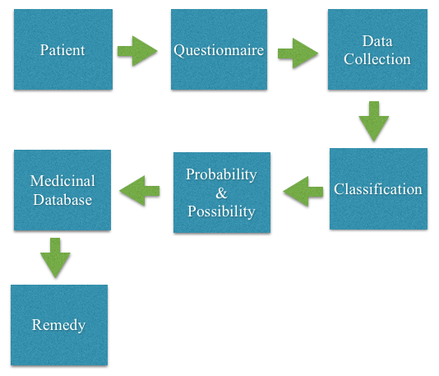
Architecture

Slide 4
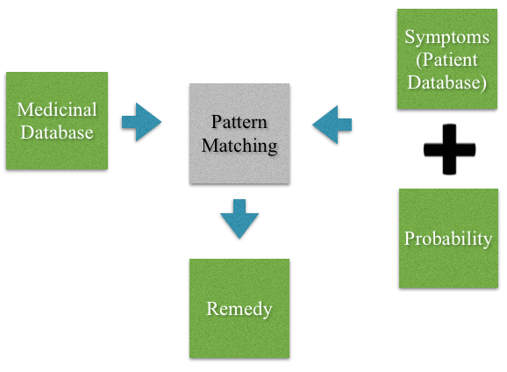
Remedy Generation of the proposed system

Slide 5
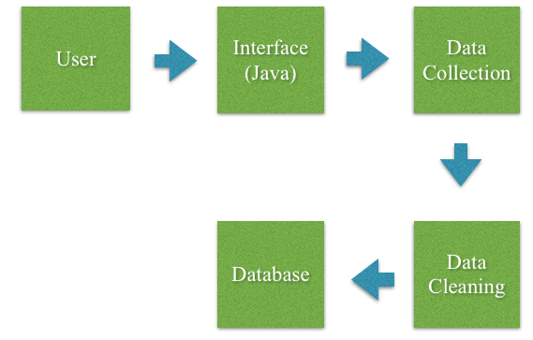
Data Collection

Slide 6
Hardware and Software
Software Details
Desktop application
Java language
Database
SQL

Slide 7
Hardware Details
Mainly software application project, hence the hardware requirement is minimal
Minimum Hardware Requirements
Server to connect to the database
2 GB Ram
Pentium processor

Slide 8
Modules
Data collection and storage & flow of questionnaire
Finding the probability
Storage of medicine database
Remedy Finder

Slide 9
Algorithm Naïve Bayes Classifier
A classifier is a process of mapping from a (discrete or continuous) feature space X to a discrete set of labels Y.
In probability theory, Bayes' theorem (often called Bayes law after Thomas Bayes) relates the conditional and marginal probabilities of two random events.
Bayes classifier assumes that the presence (or absence) of a particular feature of a class is unrelated to the presence (or absence) of any other feature.

Slide 10
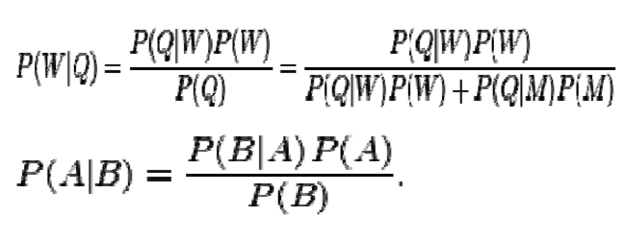
Theorem
For proposition A and evidence B,
P(A), the prior, is the initial degree of belief in A.
P(A | B), the posterior, is the degree of belief having accounted for B.
P(B | A) / P(B) represents the support B provides for A.

Slide 11
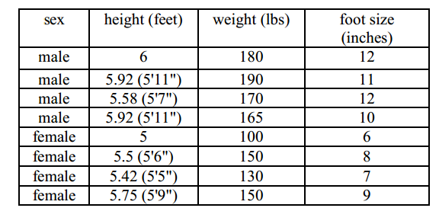
Training Set

Slide 12
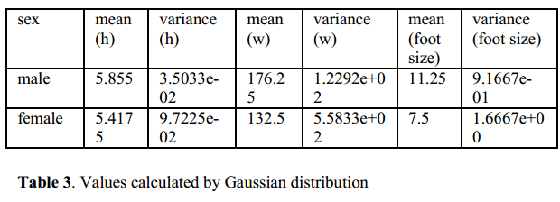
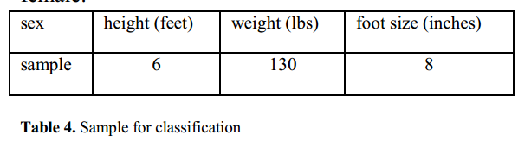
Gaussian Distribution assumption

Slide 13
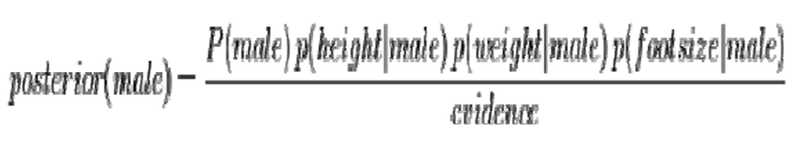
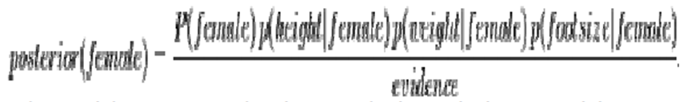
For the classification as male, the posterior is given by
For the classification as female, the posterior is given by

Slide 14
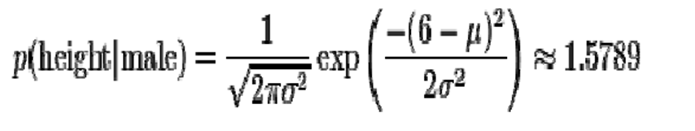
The evidence may be ignored since it is a positive constant. (Normal distributions are always positive.) We now determine the sex of the sample. P (male) = 0.5
Where μ = 5.855 and σ2 = 3.5033e − 02 are the parameters of normal distribution which have been previously determined from the training set.

Slide 15
P(weight | male) = 5.9881e-06
P(foot size | male) = 1.3112e-3
Posterior numerator (male) = their product = 6.1984e-09
P(female) = 0.5
p(height | female) = 2.2346e-1
p(weight | female) = 1.6789e-2
p(foot size | female) = 2.8669e-1
Posterior numerator (female) = their product = 5.3778e-04
Since posterior numerator is greater in the female case, we predict the sample is female.

Slide 16
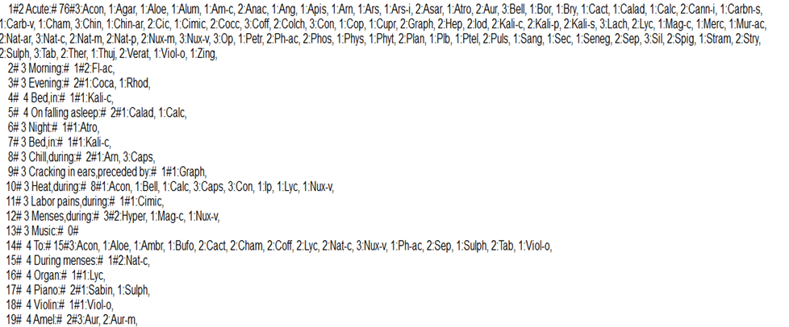
Database Details

Slide 17
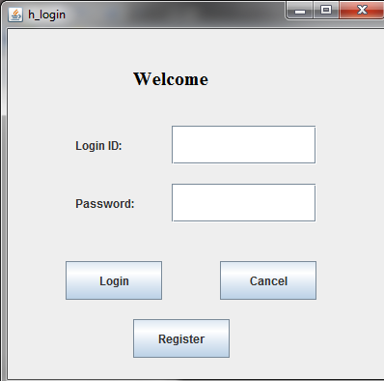
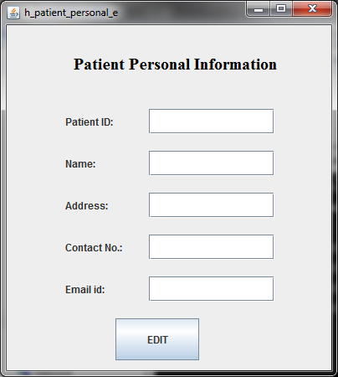

Slide 18
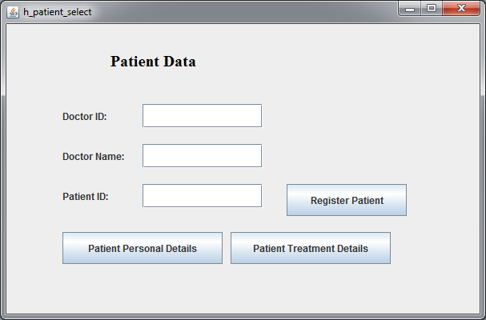

Slide 19
Literature Reviews
Title of the Paper | Author | Features
Data Extraction Methods in Medium and Large Databases | Anthony M. Dymond, Dymond and Associates, LLC, Concord, CA | Data extraction using lookup tables by different techniques. Various Notations are used to denote different combinations.
PREDICTION SYSTEM FOR HEART DISEASE USING NAIVE BAYES | Shadab Adam Pattekari and Asma Parveen | Prediction of heart attack using Data mining technique known as Naïve Bayes.
DATA MINING IN HEALTHCARE | Ruben D. Canlas Jr., MSIT, 5 August 2009 | This research paper provides a survey of current techniques of KDD, using data mining tools for healthcare and public health.

Slide 20
Title of the Paper | Author | Features
An Overview of Web Data Extraction Techniques | Devika K1, Subu Surendran2 | It focuses on study of various automatic web data extraction techniques.2 types of techniques. -Wrapper Induction -Automatic extraction Tools – DELA Data extraction label assignment

Slide 21
Title of the Paper | Author | Features
Multiple Skip Multiple Pattern Matching Algorithm (MSMPMA) | Ziad A.A. Alqadi1, Musbah Aqel2, & Ibrahiem M. M. El Emary3 | The MSMPMA algorithm scans the input file to find all occurrences of a pattern within the file, based on skip techniques.
Index Based Sequential Multiple Pattern Matching Algorithm Using Pair Indexing | Raju Bhukya, DVLN Somayajulu | This algorithm scans the input file to find all the occurrences of a pattern within a file, Based on index. Each pattern maintains index for all its occurrences.
An Index based Forward Backward Multiple Pattern Matching Algorithm | Raju Bhukya, DVLN Somayajulu | This algorithm scans the input file to find all the occurrences of a pattern within a file, Based on index. In this algorithm we divide the text file in 2 halves, then search each Halves similarly.

Slide 22
Title of the Paper | Author | Features
FAST ALGORITHM FOR MULTI-PATTERN SEARCHING | Sun Wu, Udi Manber1, | A new algorithm to search for multiple patterns at the same time is presented. The algorithm is faster than previous algorithms and can support a very large number — tens of thousands — of patterns uses the ideas of Boyer and Moore algorithm. It concentrates on typical searches rather than on worst-case behavior.

Slide 23
Title of the Paper | Author | Features
Data Mining Algorithms And Medical Sciences | Irshad Ullah | In this paper, we use Data Mining technique of Binarization for the data analysis, data accessing and knowledge discovery procedure .A solid mathematical threshold (0 to 1) is set to analyze the data. The obtained outcome will be tested by applying the approach to the databases, data warehouses and any data storage of different sizes with different entry values.

Slide 24
Title of the Paper | Author | Features
APRIORI algorithm based medical data mining for frequent disease identification | Gitanjali J1, C.Ranichandra2,M.Pounambal3 | Apriori data mining based on association rule and generates the frequency of diseases affected by patients and also the number of patients affected by these diseases . Existing electronic medical details obtained from hospitals are utilized as training data set for analysis.

Slide 25
References
PREDICTION SYSTEM FOR HEART DISEASE USING NAIVE BAYES, International Journal of Advanced Computer and Mathematical Sciences ISSN 2230-9624. Vol 3, Issue 3, 2012, pp 290-294
Blake, C.L., Mertz, C.J.: “UCI Machine Learning Databases”, http://mlearn.ics.uci.edu/databases/heartdisease/, 2004.
Chapman, P., Clinton, J., Kerber, R. Khabeza, T., Reinartz, T., Shearer, C., Wirth, R.: “CRISP-DM 1.0: Step by step data mining guide”, SPSS, 1-78, 2000.
Mrs. G.Subbalakshmi , “Decision Support in Heart Disease Prediction System using Naive Bayes ”, Indian Journal of Computer Science and Engineering.
Fayyad, U: “Data Mining and Knowledge Discovery in Databases: Implications for scientific databases”, Proc. of the 9th Int. Conf. on Scientific and Statistical Database Management, Olympia, Washington, USA, 2-11, 1997.

Slide 26
Giudici, P.: “Applied Data Mining: Statistical Methods for Business and Industry”, New York: John Wiley, 2003.
Han, J., Kamber, M.: “Data Mining Concepts and Techniques”, Morgan Kaufmann Publishers, 2006.
Intelligent Heart Disease Prediction System Using Data Mining Techniques-Sellappan Palaniappan, Rafiah Awang
Obenshain, M.K: “Application of Data Mining Techniques to Healthcare Data”, Infection Control and Hospital Epidemiology, 25(8), 690–695, 2004.

Slide 27
THANK YOU

